Slide 1
Visual Simulation
02: Low Level Computer Graphics

Slide 2
Learning Objective
To Understand the principles of 3D low-level real-time computer graphics programming
Rational for choosing a 3D Graphics library

Slide 3
What do we mean by 3D computer graphics ?
Computer Graphics: The use of a computers numerical processing ability to create a visual interpretation of a mathematical geometric model.
3D (3 Dimensional): The visual form presented within a 2D plane should adhere to established mathematical principles of depth and perspective.

Slide 4
What are the implications of these terms
Both conditions are based on mathematical principles, not human perception.
Our view of computer graphics is a 2 dimensional interpretation of a 3 dimensional mathematical model.
  We may consider a viewing window to be analogous to a real window through which is viewed a real world scene.
    What we see depends on our position, the position and orientation of the window, and the composition of the scene (3d Model).

Slide 5
What do we mean by real-time?
Technically; the instantaneous generation of an image in response to a request.
In practice; the generation of a continuous sequence of images at a sufficient rate that an animated sequence can be displayed to the viewer in order to fool their perceptive system into thinking they are seeing a moving image.
  This is the same ‘trick’ that films use.

Slide 6
What are the implications of realtime
In order to fool our perceptive system a minimum of 15 images (or frames) per second are required.
  Ideally 30 fps
  This means that we need to generate a single image in at most 1/15th of a second.
  Ivan Sutherland (one of the original developers of computer graphics) suggests that we will need a minimum of 15,000,000 triangles to accurately describe a real world scene.
    At 30 fps this is 450,000,000 triangles per second!.
  Our perception of a sequence of animated images as continuously moving scene is based on a condition know as ‘Persistence of Vision’
    For more information look at Andrew Marr’s book ‘Vision’
To achieve realtime 3D computer graphics we need to transform a 3d mathematical model into a 2D visual form very rapidly.

Slide 7
Consider two approaches
Define a mathematical model that describes the way in which we see which casts every possible ray of light from all of the light sources in the scene and follows the route every ray takes from the light source to viewers eye.
  The images generated by this method is a perfect match to the manner in which we would see these objects if they were real
Mathematically transform the key points of a shape to create a 2D transformation of that shape and just draw that resultant shape.
  This is an approximation to the manner in which we see real objects
Notes:
Draw out simple ray-tracing and poly transformation models on the whiteboard

Slide 8
What are the implications of these models
Many rays emitted from a light source will not end up striking the viewers eye.
Ray path lengths may be very variable, some rays may hit many shapes some may hit none.
This is an inherently accurate model that incorporates features such as
  Precise illumination at a global level
  Shadow
  Reflection
  Refraction and diffraction
Only change the pixel colour values for those within a drawn shape.
Only calculate the illumination values for key points on shape.
This model relies on many approximations and assumptions.
  Approximate illumination calculated at a local level for each shape.
  Shadow, reflection, etc are unimportant

Slide 9
However
Slow
  Many (relatively simple), calculations most of which do not affect the final image
This method is often referred to as ray-tracing/ray-casting.
  Produces highly photo realistic images
  Often used for film and TV special effects.
Fast
  Fewer complex calculations, all of which directly affect the final image
  Sequential instructions for the computer
This method is sometime referred to as the Traditional Graphics Pipeline (TGP)
  Rapidly produces reasonable quality images.
  Standardised calculations are easily incorporated into hardware solutions.

Slide 10
What does this mean for us?
For VR and Interactive Computer Graphics we want realtime 3d computer graphics.
  Animation and action are often more important than realistic behaviour.
    And even realistic visual effect.
    Our visual system is based on movement, is if something looks to move in a coherent manner we will often ignore the fine details of the images
      This has been proved by the ‘Gsaalt’ experiments
  Need to generate images instantly so they can reflect changes to the scene driven by user input.
However, do not want to have to write our own code to render the graphics.

Slide 11
Solution.
Use a library that someone else has created
  Many Types
    PHIGS
    direct3D
    OpenGL
    Renderware
  Many have undergone significant development time, and evolved into efficient, powerful tools.
    OpenGL first emerged as irisGL in the 1980’s
    direct3D is now on version 9+
  Allow us to concentrate on functionality of our application, rather than just the rendering of images
  All are based on the Traditional Graphics Pipeline

Slide 12
If there are so many why choose OpenGL
Widely accepted open standard
  OpenGL is an open standard that is not controlled by any one company.
    Originally created as Iris GL by Silicon Graphics
    SGI presented this as an open standard, hence the name change to OpenGL
  Most hardware vendors adhere to the OGL standard.
    OpenGL specifies the interface and the graphics pipeline
      It is up to the hardware vendors to decide how they implement this
        Most graphics cards implement opengl differently
Multi-platform.
  OGL is available for most operating systems and hardware platforms
    MS Windows
    SGI Irix
    Mac OSX
    Sun
    HP
Active distributed research and development
  ARB continually reviewing and evolving standard to reflect industrial needs
  Large community of developers and users
    http://www.opengl.org
    http://nehe.gamedev.net
Note: if you use any sources from these, or any other sites, in your course work it must be referenced

Slide 13
What is OpenGL
Computer
Graphics
Card
Graphics
Bus

Slide 14
What is OpenGL
Open GL
Computer
Graphics
Card
Graphics
Bus

Slide 15
What is OpenGL
Open GL
Computer
Graphics
Card
Server
Client
Graphics
Bus
Software interface to graphics hardware
  @ 150 functions for controlling the rendering of 2 & 3 D images.
    May think of this as a client/server system with most of the functions interrupted by the server into instructions applied by the client.
      Small number of functions are directly applied to the client. These are client side functions.
Streamlined hardware-independent interface.
  Efficient
  Can be applied to many hardware platforms
    Only defines rendering functions, does not provide commends for windowing tasks

Slide 16
Core principle
OpenGL as a State Machine

Slide 17
OpenGL
Allows the user to issue a sequential set of instructions to the Graphics Card
  Changes to Attributes & Modes
  Instructions to draw primitives
However
  To make it fast their is a simple principle used here
    No backward referral to instructions
Therefore
  Must define the state of the OpenGL system before issuing a drawing instruction

Slide 18
States
OpenGL manages several state ‘stacks’ which define the current rendering state
  These include
    Attribute Stack
      Material and Colour
      Lighting and environmental conditions
      Rendering state
    Transformation stack
      World and Camera Transformations
Modes and Attributes are ‘pushed’ onto these stacks, and can also be ‘pop-ed’ of the top of them
  No indexed access

Slide 19
States
Modes
  Enable & Disable functions
    Eg glEnable & glDisable
      One argument that indicates the feature that should be enabled or disabled
        Eg glEnable(GL_LIGHTING);
Attributes
  Allows modification of parameters
    Specific functions for each
      Eg
        glMaterial3f(1.0f, 0.0f, 0.0f)
        glTranslate3f(20.0f, 0.0f, 2.0f);
Active state is the sum of all the modes and attributes (in the order in which they were applied) in the stack

Slide 20
Managing State
Ideally we should only modify the current state
  However, it can be very easy to loose track of what the current state is
    And very slow to query this
OpenGL allows us to place markers in the stack
  glPush()
    places marker in the matrix stack
  glPushAttribute(...)
    places marker in the attribute stack for the named feature set

Slide 21
Managing State
We can return to a known state by removing the top level marker (push) from the top of the stack
  glPop()
    Remove all matrix operations since the last push from the top of the matrix stack
  glPopAttribute()
    Remove all mode and attribute changes (for the last named push) from the top of the attribute stack

Slide 22
Managing State
Therefore
  While OpenGL has no ‘undo’ function we can manage state effectively using the stack system
  Must remember how many levels we have pushed onto each stack
    Removing too many may cause a run-time error
      OpenGL has no error checking
    Only guaranteed a set number of levels for each stack
      Dependent on graphics hardware
      Typically 32

Slide 23
Practical Issues

Slide 24
What does OpenGL allow you to do
Construct shapes from geometric primitives
  Points
  Lines
  Polygons
  Images
Arrange objects in 3D space and select the vantage point for viewing the composed scene.
Calculate the colour of all rendered objects.
  Explicitly assigned
  Determined from specified lighting conditions
  Evaluated from a defined texture
  Any combination of these
Covert the mathematical description of objects and their associated information into pixels on a screen
  Rasterisation.

Slide 25
What does OpenGL NOT allow you to do
File IO
  OpenGL does not provide any file input/output functionality
    You must write your own
      3D -> VRML, 3DS, etc
      2D -> jpeg, gif, bmp, etc
Windowing functionality
  OpenGL is designed to be platform independent
    Windowing functionality is specific to the OS
    GLUT is a library that can help with this

Slide 26
Conclusion
3D computer graphics requires us to transform a 3D mathematical model into a 2D image
  Needs to be fast
    To allow 3D animation
  Toolkits (libraries) exist to make this easier
    Low level approach
      Drawing primitives
      No concept of objects or structural relationships

Slide 27
Practical Session
OpenGL

Slide 28
Workspace
You are provided with a Microsoft Visual Studio workspace solution
  mscVisSim
This contains several directories and solution files for both MSVC 2008 and MSVC 2010.
  Always open the solution file for the projects
    Do not open individual project files directly

Slide 29
VC Projects
3 projects are included in the solution
  raaOpenGLApp
    A simple OpenGL application
  raaRobotBuilder
    An example application demonstrating building of Scene Graph structure using OSG
  raaRobotController
    A basic OSG application that will act as the foundation of your assessment work

Slide 30
raaOpenGLApp
This is a basic OpenGL application
  Uses a utility library (GLUT) to manage the windowing events
  Allows you to use OpenGL to draw objects
    2 Triangles
    1 teapot
  Allows simple navigation of the scene
Over the next 2 practical session we will use this as a platform to explore low level graphics

Slide 31
Tasks 1
In this session
  Open the source file ‘raaOpenGLApp.cpp’
    This is a simple C programme contained in a single source file
  Read through the code and make sure you understand what is going on in it.
  Run the application
  Try modifying the code
    Change colours of the objects
    See if you can change the positions of the objects
    Make the teapot rotate
    Add your own simple polygon shape

Slide 32
Fundamentally
Explore and experiment
  Try things and see what happens
    I will help by explaining and working with you
Get familiar with the code and the programming environment
Ask me questions

Slide 33
Tutorial: OpenGL

Slide 34
Learning Objective
To familiarise ourselves with the OpenGL philosophy

Slide 35
Introduction to OpenGL
Several of software libraries have been developed over the years to support the development of graphics applications
  Graphical Kernel System (GKS)
  Programmers Hierarchical Graphics Systems (PHIGS)
These are International Standards that, in their time, reflected the need to utilise the current technologies
  GKS → 2-D pen-plotters
  PHIGS → 3-D CAD community
OpenGL was based on GL, a 3-D graphics library similar to (PHIGS), devised by Silicon Graphics with a pipeline architecture so that it could be implemented using VLSI
  high-speed real-time rendering
  Sequential list of instructions

Slide 36
OpenGL philosophy
OpenGL was the results of GL users wanting to use the advantages of the graphics pipeline and fast rendering techniques on other platforms ...
  GL open to all platforms
… including UNIX/Linux, Macintosh, OS/2 and Windows
As an open standard, is it controlled by an OpenGL Architectural Review Board, which has members taken from the main computer companies
  SGI, IBM, Microsoft etc
Information, specifications, tutorials, downloads can be obtained from:
  http://www.OpenGL.org/

Slide 37
Implications

Slide 38
OpenGL Functions
OpenGL contains over 200 functions:
Primitive functions
  vertex data (point, lines, polygons, and pixel data (images, bitmaps)
Attribute functions
  colours, line types, lights, textures
Viewing functions
  viewing transformations
Control functions
  start/termination, turn on/off features
In the OpenGL Utility Library (GLU)
Modelling functions
  curves, surfaces

Slide 39
Anatomy of a OpenGL function
All OpenGL functions follow the same pattern
  All start with gl
    Or glu for the utilities library
  All contain a description of the command
  Most specify the type of the arguments if there are many choices
    Eg 3f -> states that the function requires three floats as an argument
  Some may only be used within a context block
    Declared by a pair of gl function
glVertex3f(…);
glVertex2f(…);
glVertex3fv(…);
glColour3f(…);
glBegin(GL_QUADS);
  glVertex3f(x,y,z);
  glVertex3f(x,y,z);
  glVertex3f(x,y,z);
  glVertex3f(x,y,z);
glEnd();

Slide 40
OpenGL primitives
The primitives in OpenGL are points, line-segments and polygons
Vertices are combined to form an OpenGL primitive by enclosing them between glBegin and glEnd
glBegin(GL_TRIANGLES)
glVertex2f(0.0, 0.0);
glVertex2f(0.75,0.0);
glVertex2f(0.75,0.5);
glEnd();
  defines a TRIANGLE with vertices at (0.0,0.0), (0.75,0.0), (0.75,0.5)

Slide 41
OpenGL example 1
where myDisplay is defined as:
static void myDisplay(void)
{
glClear(GL_COLOR_BUFFER_BIT);
glBegin(GL_TRIANGLES);
glVertex2f(0.0, 0.0);
glVertex2f(0.75,0.0);
glVertex2f(0.75,0.5);
glEnd();
glFlush();
// swap buffers
}

Slide 42
OpenGL conventions
The example highlights several OpenGL conventions:
  all GL function names start with gl...
  the parameter in glBegin defines the type of primitive
  vertex functions have the form
    glVertexNT( ……
    where N is the number of parameters, typically 2 for 2-D coordinates etc
    T is the type of the parameter, f=float(real), i=integer etc

Slide 43
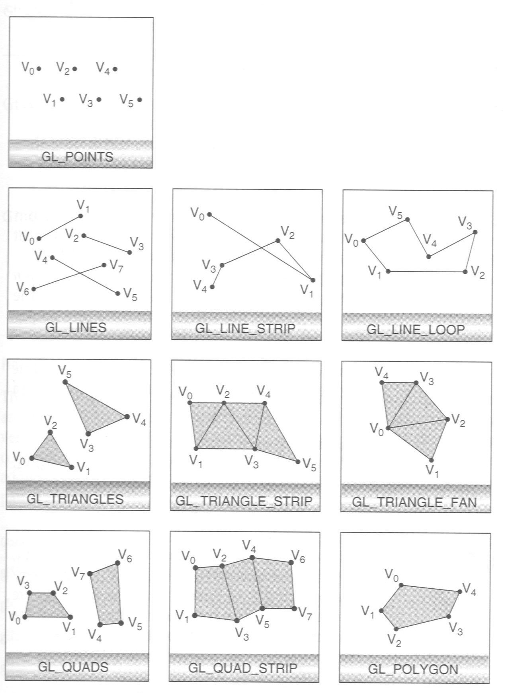
More OpenGL primitives

Slide 44
Transformations
While the functions for drawing geometry are powerful, they rely on the absolute positioning of the vertex.
  There are two forms of transformations of this data we need to consider in order to convert this data for display
    World space transformation
      Transforms the vertex data within the 3D world to position, orientate and scale the object
    Projection space transformation
      Applies a perspective transform of the 3D world to create a 3D visual form
      Defines the viewing position of the user within the 3D world

Slide 45
How does OpenGL do this?
OpenGL maintains two matrix stacks to define the transformation of the space that the data will be drawn into
  Model view matrix
  Projection view matrix
OpenGL provides 3 key functions to manipulate these matricies
  glTranslate
  glRotate
  glScale
The order of these operations is important
  T -> R -> S is not the same as S -> R -> T
Importantly these operations transform the space the object will be drawn into
  Any change to the matrices will affect all drawing operations that follow

Slide 46
Thinking about transformations
We have seen that the transformation operations are non-cumulative.
  Consider the two conditions
Rotate, then translate
Translate then rotate

Slide 47
Lighting
We could
  Render every primitive with a single solid colour
    However this will create a very flat looking scene
      It will not be possible to resolve the complex form of a 3D shape
In the real world this information is presented by the complex interplay between the light emitted by a light source and the reflection of that light by the surface.
OpenGL provides a simple approximation for this
  Phong lighting model
    Local illumination model based on 3 forms of reflection
      Ambient
      Diffuse
      Specular
  To use this we need to define both a light source and the surface reflection charateristics
    Light source
      glLight
    All changes to the light source will affect the primates draw afetrwards
    Light sources are also affected by transformation matricies

Slide 48
Attributes (Lighting)
The surface material of a primitive is defined by the current attribute set
  specifically glMaterial
  Need to define attributes for the differing reflection modes
    Ambient
    Diffuse
    Specular
Changes to the attributes will affect all primatives drawn after they are made

Slide 49
Attributes (general)
Material is one aspect of the attribute stack
  Others include
    Drawing style
    Texture
    Fog
    Blending (Transparency)
Each attribute may be switched on and off
Each attribute has a set of parameters for use
This defines the rendering state that a primitive will be drawn into

Slide 50
Stacks (Managing state)
OpenGL uses a sequential set of instructions to control the rendering process
  Therefore changes to the state will affect all subsequent drawing commands
  Changes to the matrix will affect all subsequent drawing commands
OpenGL therefore operates as a state machine

Slide 51
Managing state
Enabling and disabling states allows us a fine level of detail
  However each state operation has a performance penalty
  Querying the state of a state is very computationally expensive.
    It is often faster to just set a value rather than identifying it’s current state
OpenGL provides us with several ways to manage this.
  Bitwise combination of state types
    We can combine the state declarations into a single argument for use in the enable/disable functions
      glEnable(GL_FOG|GL_POLYGON_MODE|GL_LIGHTING)
        This uses the pipe symbol that denotes a C bitwise addition
    We can also use the Attribute Stack to allow us to store a known state configuration and return to it

Slide 52
Stacks
Push State
Pop State
Stacks are a common OpenGL construct that allow us to define a specific state configuration that we can return to
Operate as a LiFo construct that allows use to store a set (or layer) of state configurations
State 2
State 1
State 0

Slide 53
Stacks
For a defined state configuration we can push a level onto the stack that records that configuration
  Records both the state of a mode and the values of the mode parameters
  glPushAttrib(mode)
    Argument can be a single mode, a collection of modes or the GL_ALL_ATTRIB_BITS flag that will record all mode changes within the attribute state
      Eg
        GL_FOG_BIT
        GL_DEPTH_BUFFER_BIT
Applied state:
Fog=true
PolyMode=Linear
Push State (GL_FOG)
State 0
GL_FOG
Fog=true
PolyMode=Linear

Slide 54
Stacks
Can now change the value of a mode and this will be recorded in our new state
Applied state:
Fog=false
PolyMode=Linear
State 0
GL_FOG
Fog=false
Fog=true
PolyMode=Linear

Slide 55
Stacks
Applied state:
Fog=true
PolyMode=Points
Can continue to add states to the attribute stack and modify values within the top level state
  Most implementations of OpenGL only maintain 32 stack levels within hardware memory
    Opengl can become very slow if you exceed this
  Stack levels only record the modes they are instructed to
  Current applied state is the resultant state at the top of the stack
Push State (GL_POLYGON_MODE)
State 1
GL_POLYGON_MODE
PolyMode=Points
State 0
GL_FOG
Fog=false
Fog=true
PolyMode=Linear

Slide 56
Stacks
Pop State
To return to previous state we need to pop the state level off the stack
  glPopAttrib
    Does not require an argument as this releases the last level regardless of the mode/s
    Most OpenGL implementations have undefined behaviour if you try to pop a stack level where one does not exist
State 1
GL_POLYGON_MODE
PolyMode=Points
Applied state:
Fog=true
PolyMode=Linear
State 0
GL_FOG
Fog=false
Fog=true
PolyMode=Linear

Slide 57
What does an OpenGL program look like?
Most OpenGL applications are comprised of two parts
  Initialisation, where the OpenGL system is initialised and the base states set
  Rendering, where the scene is drawn to the viewing window
Initialisation
Rendering

Slide 58
Summary
OpenGL
  Platform independent instruction set for drawing 3D (and 2D) computer graphics
    Low level
      No file IO
      No Windowing functionallity
    Fast
      Sequential instructions passed to graphics hardware
      Highly optimized

Slide 59
Summary
Issues
  While OpenGL is very useful
    Low level means that it is not very re-usable
      Applications tend to be written for specific use
      Does not allow modelling of data and instructions

Slide 60
Summary
What are we actually doing when we draw 3D real-time graphics

Slide 61
Summary
Define geometry in a 3D orthogonal space

Slide 62
Summary of OpenGL 1st lecture
Define a perspective transformation to enable transformation of 3D geometry to a 2D planar description
Defined as a trapezoidal box enclosed by 6 planes
  Near clip plane is mapped to the display screen
  Far clip plane is limit of view
  4 remaining planes denote the view frustrum
    GL will still draw the objects outside these planes
      But we will not see them on the screen

Slide 63
Summary of OpenGL 1st lecture
If the scene, or the camera is static we only need to render this scene when the window needs re-displaying
If any part of the scene, or the camera, is changing we need to continually redraw the scene to capture the animation
  Ideally at about 60 Hz

Slide 64
Summary
Application
GLUT
GL
GLU
OS

Slide 65
Practical Use
GL & GLU are already installed on your windows systems
  Part of the operating system environment
  To use these in a C application
    Must include
      #include <windows.h> -> needed for OGL
      #include <GL/gl.h>
      #include <GL/glu.h>
    Must also tell the ‘linker’ to use the related libraries
      Opengl32.lib
      Glu32.lib

Slide 66
Summary
OpenGL is a 3D graphics API
  Allows us to send sequential instructions to the graphics hardware
Does not support
  Windowing
  File IO
While it is very powerful
  It is not very usable

